Slide 1
Introduction to ‘Science’
MET 2010

Slide 2
Goals of this presentation
To introduce fundamental ideas about ‘science’ to all students, regardless of major
To discuss the scientific method in detail
To make clear the activities and assumptions of a scientist
To discuss the role of science in society today

Slide 3
www.dictionary.com
The observation, identification, description, experimental investigation and theoretical explanation of phenomena. Such activities restricted to a class of natural phenomena. Such activities applied to an object of inquiry or study.
Methodological activity, discipline or study: I’ve got packing a suitcase down to a science.
An activity that appears to require study and method: the science of purchasing.
Knowledge, especially that gained through experience.
The first version is what is known as the scientific method. The others rely on colloquial usage of the word ‘science’
Notes:
Possibly the first definition resource for most students.
First definition is okay; others are colloquial or rely on any information or knowledge to invoke something ‘scientific’.

Slide 4
L.B. Railsback, Ph.D. Professor, Dept. Geology, University of Georgia http://www.gly.uga.edu/railsback/railsback.html
The concerted human effort to understand, (or to understand better) the history of the natural world and how the natural world works, with observable physical evidence as the basis of that understanding. It is done through observation of natural phenomena, and/or through experimentation that tries to simulate natural processes under controlled conditions.
This is the ‘best’ definition, because it tells you what science is...
Notes:
Definition by a scientist; a geology professor at U Georgia, who has written extensively online about ‘science’ and its definitions.
Important are the words
Effort - it is an attempt, and may not be accurate all the time;
Observable, observation - evidence must have been seen, measured, repeated to be considered reliable.
Experimentation - often situations are controlled to find a single cause and effect that will have a repeatable and predictable result.

Slide 5
So what is SCIENCE?
A body of knowledge and a method?
An activity and the results of that activity?
An attempt to understand the natural world, based on observation and experimentation?
Something difficult to get a really good handle on...

Slide 6
Outline of this presentation
What are scientists?
Why do scientists do science?
Science & ‘change’
What science is not...
The scientific method, step by step
Benefits of the scientific method
‘good’ v.s. ‘bad’ methodology
The importance of science today
Definitions of terms used by scientists

Slide 7
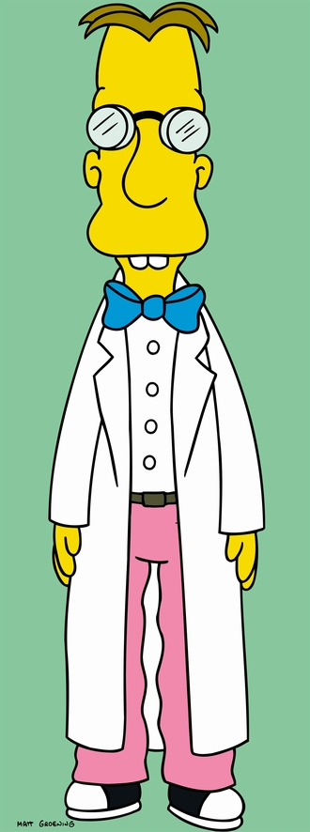
Common Characteristics Of SCIENTISTS
Make and record observations of nature, or of simulations of nature.
In order to learn more about how nature, in the broadest sense, works.

Slide 8
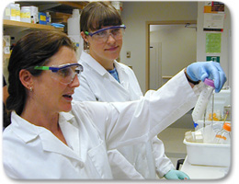
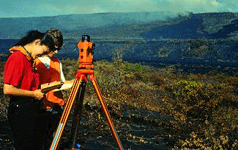
Such Observations of nature can be simulated in the lab…
…or measured in the field.
It’s ALL Science!

Slide 9
Common Characteristics Of SCIENTISTS
Recognize their own fallibility
Never claim to be “All Knowing”
Constantly reexamine themselves and their fields by...
Striving to demonstrate that old ideas are often wrong
The ideas of scientists a century ago or perhaps just a year ago
Instead, new ideas may better explain nature.

Slide 10
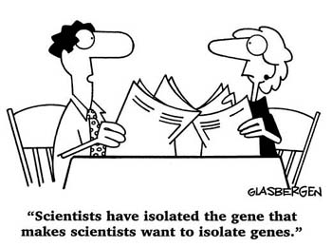
Why Do Scientists Do Science?
Collect data to:
Test new ideas, or
Disprove old ones.
Motivated to make new discoveries that:
Change the way we think about nature
Explain problems to which the solution was previously unknown or misconceived

Slide 11
What About All Of This Change?
People generally don’t like change.
Wars, riots and persecution are just some of Man’s reaction to change
Science, though, is constantly undergoing change
Naturally, then, many people rebel against science
Will often use its changing nature as ‘proof’ that “those scientists don’t know what they’re talking about!”

Slide 12
What About All Of This Change?
Such change, though, is simply progress towards a better understanding of nature
As the body of knowledge produced by science is refined and expanded upon
We must be comfortable with the fact that theories come and go, or are at least modified, as old ideas are questioned and new evidence is discovered.

Slide 13
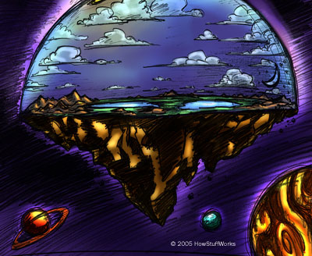
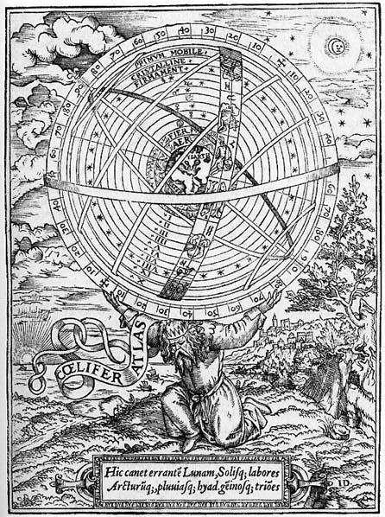
We often reevaluate what we previously believed to be ‘True’

Slide 14
"That fellow Einstein . . . every year retracts what he wrote the year before".
- Albert Einstein remarking of himself

Slide 15
Example: the origin of streams
Question: where does the water that runs in streams, rivers and lakes come from?
You have probably answered ‘rain’ or ‘precipitation’. Can you prove this is so?
In the 1600s it was commonly believed that streams were fed by underground flows of water that went up from sea level to the tops of hills and mountains… Why?!

Slide 16
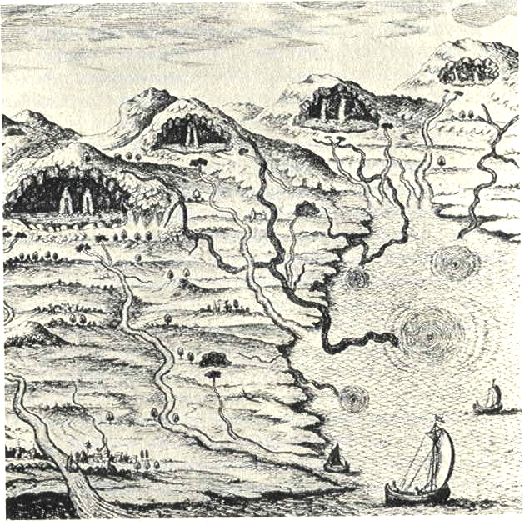
Kircher’s diagram (1664/5) showing subterranean ‘streams’ (in black) and their ‘springs’

Slide 17
Example: the origin of streams
Not until measurement of the exact quantities of precipitation, stream flow and groundwater seepage was possible did scientists work out that there really WAS enough rain & snow fall to account for all flow in streams and rivers…
Gravity and the idea of underground streams were not considered a problem!

Slide 18
Example of ‘good’ science
The Theory of Plate Tectonics
Alfred Wegener first proposed the Theory of Continental Drift in 1912.
However, his evidence was mostly circumstantial (shapes of continents, distributions of rocks & fossils)
He did not have an explanation as to how the continents drifted.
As such, the proposal was not accepted by the scientific community

Slide 19
Example of ‘good’ science
During the 1950s & 60s studies of the sea floor showed evidence of seafloor spreading:
Mountain ridges, deep trenches, active volcanoes, paleomagnetic ‘stripes’ and incredibly young oceanic crust.
Individual hypotheses can be invoked to explain each individual observation…but the only explanation (so far?) for ALL observations is the Theory of Plate Tectonics.
Convectional cells are invoked to explain motion, but are hypothetical.

Slide 20
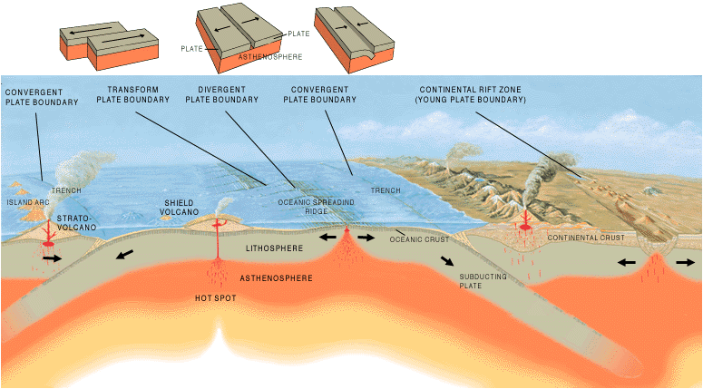

Slide 21
Breakup of Pangaea
Notes:
To view this animation, click “View” and then “Slide Show” on the top navigation bar.

Slide 22
Example of ‘bad’ science http://www.pbs.org/wgbh/nova/holocaust/pseudoscience.html
The Greenhouse Effect
Observation
Weather satellite measurements, taken at the altitude of a low-Earth orbit satellite, show a decrease in the temperature of Earth's upper atmosphere over a 20-year period.
Conclusion
Not only is the Earth's atmosphere not warming due to the greenhouse effect, it's actually cooling.
What factor might invalidate the conclusion?

Slide 23
Example of ‘bad’ science http://www.pbs.org/wgbh/nova/holocaust/pseudoscience.html
The Greenhouse Effect
What factor might invalidate the conclusion?
The data are correct, but…
fails to take into account that, over a 20-year period, atmospheric drag had significantly lowered the satellite's orbit.
Therefore, the temperature readings, over time, were taken at progressively lower levels.
At this level of the atmosphere, temperature decreases with lower altitudes.
Thus there were hidden variables not considered by the scientist.

Slide 24
What science is NOT!
An expression of feelings or emotion, gut reaction without precise proof
A belief, a religion or religious expression
Technology or engineered devices
It may lead to their development, but does not require them

Slide 25
What science is NOT!
Truth or Absolute Certainty
Facts are certain; although theories & hypotheses use all known facts, they still cannot be PROVEN
People that describe the unobservable with absolute certainty are not scientists

Slide 26
" No amount of experimentation can ever
prove me right; a single experiment can
prove me wrong.".
- Albert Einstein

Slide 27
The Scientific Method (as defined by a scientist: Gottlieb 1997)
Observation
Hypothesis formulation
Experimentation & hypothesis testing
Search for causes
Conclusion: accept or reject hypothesis
Classification
Communication

Slide 28
Step 1: Observation
‘Observation’ is also data collection
data are the collected facts
data are always plural;
data set is singular
Data collection can be EXPERIMENTAL
e.g. by a chemist or biologist, simulating reality with controlled conditions
Data collection can be OBSERVATIONAL
e.g. by a geologist or meteorologist, collecting information outside or from instruments

Slide 29
Step 1: Observation
What is a fact?
Should be objective (fair, unbiased)
Should be quantifiable or measurable
Should be repeatable or reproducible
Concerns the function and structure of the world
Is not to be believed, but DEMONSTRATED
Examples: Water flows downhill. The atmosphere consists of 21% oxygen. Diamond will cut sandstone.
Not facts: The sun will rise tomorrow. A hurricane will hit Florida on Sept 29, 2010. Extraterrestrial life exists.

Slide 30
Step 2: Hypothesis formulation
What is an hypothesis?
An educated guess, an idea, to be tested
A statement consistent with ‘natural laws’, not invoking any supernatural phenomena
A statement designed to provide prediction
A statement made in terms of cause and effect
An hypothesis may be accepted or rejected, or rejected then modified for later study

Slide 31
Step 2: Hypothesis formulation
How is an hypothesis worded?
H0 (the null hypothesis): Water flows downhill
H1 (first alternate hypothesis): Water does not flow downhill
Note that H1 doesn’t tell you anything, other than to reject H0.
There may be several alternate hypotheses (H2, H3), which could be more specific, but must contradict H0.

Slide 32
Step 3: Experimentation & hypothesis testing
Data are collected for hypothesis testing:
Observations are made under controlled conditions, so that the hypothesis may be tested. The controls should ensure that:
data are reliable
all variables are known
variables are comparable
there is no researcher bias

Slide 33
Step 3: Experimentation & hypothesis testing
How do you test an hypothesis?
Having collected data, they are statistically analyzed (reduced) to find their true significance.
Look for patterns & relationships. Final results are compared to the hypothesis.
An hypothesis may be accepted, rejected or modified for later experiments.

Slide 34
Step 4: Search for causes
Having accepted, rejected or modified the original hypothesis
The experiment itself, its design and its execution should be re-evaluated for errors, inconsistencies or bias.
If all is well, move on.
Ideally, one or more hypotheses will lead to the cause behind the effect you are observing (e.g. gravity causes water to flow downhill) – so to PREDICTION

Slide 35
Step 5: Conclusion
The hypothesis is accepted, or rejected, or rejected but modified for another experiment or set of observations
Rejection of H0 is a positive outcome; the researcher learned something
A single conclusion may not be reached
This hypothesis may lead to others, to more experiments, to more testing…

Slide 36
Step 6: Classification
Eventually, one or more hypotheses may show a scientifically significant pattern. The hypothesis may:
Support, or refute, an existing theory
Lead to formulation of a new theory
Lead to formulation of new scientific principles or ‘laws’

Slide 37
Step 7: Communication
The discoveries of a scientist can only be added to the greater body of knowledge if they are presented to the scientific community.
Allows science to be ‘self-correcting’
erroneous data or ideas are likely to be spotted by the greater scientific community, so the error is quickly eliminated from the body of knowledge

Slide 38
Step 7: Communication
This takes place either verbally at meetings (conferences) or by writing in academic journals
To publish in a journal, a paper is submitted to the editor, and then goes through ‘peer review’.
It is read by experts in the specific field; these experts may accept it without changes, require changes, or reject it
Publishing enhances the reputation of the scientist, leads to promotion and provides constructive criticism or useful feedback.

Slide 39
Terminology
Fact: objective, quantifiable, repeatable, demonstrable phenomenon concerning the function and structure of the natural world
Law: a statement of order and relation in nature that has been found to be invariable under the same conditions (e.g. the law of gravitation, the ideal gas law). No explanation of cause.
Hypothesis: an idea to be tested, a statement consistent with natural laws, designed to provide

Slide 40
Terminology
Theory: statement that explains the mechanism underlying some natural phenomena. Tends to unite ALL information from a variety of sources into an overall concept. Based on multiple facts, multiple hypotheses.
An accepted theory is the CURRENT explanation for phenomena; it is subject to change if a better explanation is found.
Outside science, a ‘theory’ is much less certain: a hunch, a guess, an estimate...

Slide 41
Terminology
Statistical significance:
Are the limited number of observations made by a scientist (maybe limited to 30 or to 3000) true for every single occurrence of this phenomenon?
Can the data be generalized so that they are true in the majority of instances?
If so, they are statistically significant.
Confidence intervals are generally set at 95% - the observation will be true 95% of the time

Slide 42
Terminology
Induction: process of reasoning from the particular to the general
Deduction: process of reasoning from the general to the specific
By induction (observation of events) and deduction (using known principles), new hypotheses are formulated. These are tested; as the results of tests satisfy the conditions of the hypotheses, laws are arrived at - by induction. From these laws future results may be determined by deduction.

Slide 43
Terminology
Empiricism: a belief that all ideas are derived from experience; therefore, knowledge of the physical world can be nothing more than a generalization from particular instances and can never reach more than a high degree of probability (www.encyclopedia.com)
Rationalism: a theory that holds that reason alone, unaided by experience, can arrive at basic truth regarding the world (www.encyclopedia.com)

Slide 44
Terminology
Bias: A preference or an inclination that inhibits impartial judgment, favoring one outcome over another. May take the form of a systematic statistical or testing error
Plagiarism: the act of taking someone else’s words, ideas or writing, and presenting them as your own
Reference, citation: quotation or recognition of an authority on a subject, usually someone who has done previous research in this field

Slide 45
Terminology
Paradigm: A set of assumptions, concepts, values, and practices that constitutes a way of viewing reality for the community that shares them, especially in an intellectual discipline (www.dictionary.com)
Research: Scholarly or scientific investigation or inquiry; close, careful study (www.dictionary.com)

Slide 46
Sources and references
For more on ‘What is Science?’ go to
http://www.gly.uga.edu/railsback/railsback_1122science1.html (Railsback 2000)
http://acept.la.asu.edu/courses/phs110/course_info/class_notes/defn_science/defn_science.html
http://www.eas.slu.edu/People/CJAmmon/HTML/Classes/PhysicalGeology/Notes/WhatIsScience/P01.html
http://www2.gasou.edu/geol/1.2TOC.html
http://www.ucmp.berkeley.edu/people/jlipps/science.html

Slide 47
Sources and references
For details on science vs. religion, see
http://www.theharbinger.org/articles/rel_sci/gottlieb.html (Gottlieb 1997)
For common errors in describing scientific principles
http://www.ems.psu.edu/~fraser/BadScience.html
For info on multiple working hypotheses
http://www.gly.uga.edu/railsback/railsback_chamberlin.html

